Slide 1
DAYALEKTOR
Belchez, Maica L. Carpio, Aira Joyce A. Gardon, Jana Marie G. Haboc, Florence Gail G.

Slide 2
Overview
Lean Canvas
Product and Services
Prototype

Slide 3
The Lean Canvas
DAYALEKTOR
06-Aug-2017
Problem
(Pain Points)
Solution
(Product or Service)
Situational Benefits
Marketing Message
Customer Segments
Target Customers
No more language barrier
Translate Philippine dialects into English or Filipino languages and vice versa.
Filipinos/Foreigners
Language Barrier
Improve communication
“Never get lost in translation.”
Improve vocabulary and check pronunciation.
Both female and male
Lessen misunderstanding
Auto-responds to any set of phrases.
Misunderstanding
Features
Channels
Path to Customers
18 and above
Philippine Dialect Translator
Direct voice delivery as a better experience.
Social Networks
Offline Vocabulary Library
Tourists
The app will pronounce the word
Blog
Text-To-Speech
Advertisement
Travelers
Delegated Correction
Ask someone, in the forum, for correction
Email
Website
Cost Structure
Customer Acquisition costs
Distribution costs
Hosting
People, etc.
Revenue Streams
Revenue Model
Life Time Value
Revenue
Gross Margin
Mobile Development
Marketing
Stakeholders
Hiring Solutions
Advertising
Salaries
Paid customers
Development Fees
PRODUCT
MARKET

Slide 4
Problems(Pain points)
Misunderstanding
Language Barrier

Slide 5
Solutions(Products or Service)
No more language barrier
Improve communication
Lessen misunderstanding

Slide 6
Features
Philippine Dialect Translator
Offline Vocabulary Library
Text-to-Speech
Delegated Correction

Slide 7
Situational Benefits
Translate Philippine dialects into English or Filipino languages and vice versa
Improve vocabulary and check pronunciation
Auto-respond to any set of phrases
Direct voice delivery as a better experience
The app will pronounce the word
Ask someone, in the forum, for correction

Slide 8
Marketing Message
“Never get lost in translation”

Slide 9
Channels
(Path to Customers)
Social Networks
Blog
Advertisement
Email
Website

Slide 10
Customer Segments
(Target Customers)
Filipinos/Foreigners
Both female and male
18 and above
Tourists
Travelers

Slide 11
Cost Structure
Mobile Development
Advertising
Marketing
Salaries

Slide 12
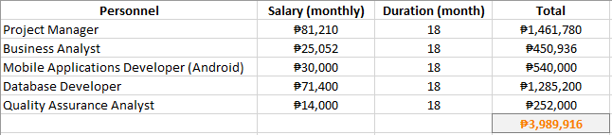
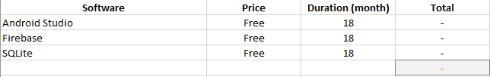
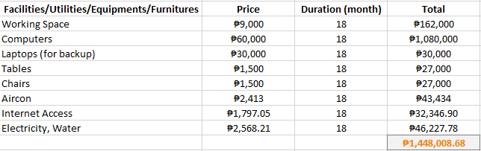

Slide 13
Revenue Streams
Stakeholders
Paid customers
Hiring solutions
Development fees

Slide 14
GENERAL COMPANY DESCRIPTION

Slide 15
Mission(s):
To provide a tool that connects people to local Filipino users, bring them together, share, and create information.
To improve communication and deliver information in multiple dialects.

Slide 16
Vision(s):
To bring local dialects to life.
To improve human interactions in the Philippines.

Slide 17
Goal(s):
To be one of the most successful and trusted company in the Philippines.

Slide 18
Objective(s):
To be able to help users in regard to language barriers and misunderstandings between foreign people or Filipino people.
To let users be familiarized with Filipino dialects.

Slide 19
PRODUCTS AND SERVICES

Slide 20
Dayalektor translates the following:
Languages
English
Filipino
Dialects
Bikolano
Cebuano
Hiligaynon (Ilonggo)
Ilocano
Kapampangan
Pangasinense
Tagalog
Waray

Slide 21
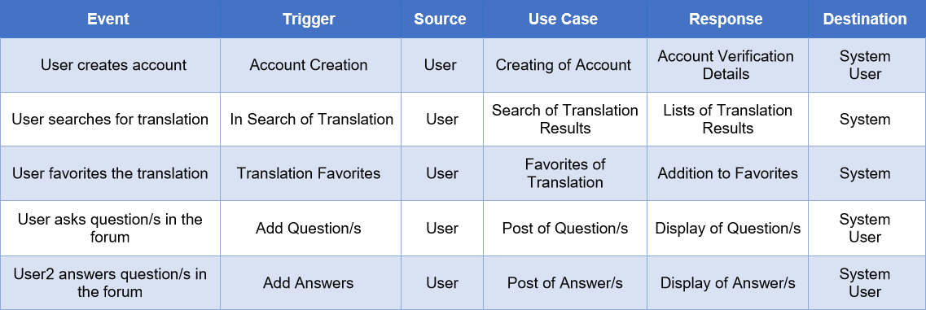
Event Table

